Slide 1
Excel
Raymond Tsang
2012-02-01

Slide 2
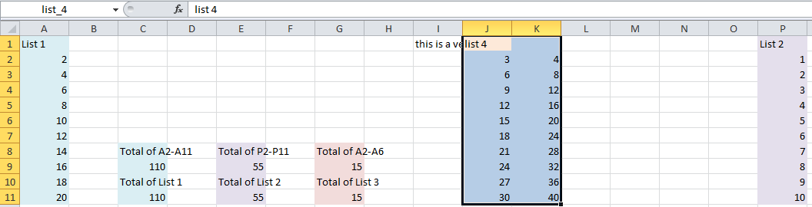
Define Name
Formulas -> Defined Names -> Create from Selection
Formulas -> Defined Names -> Name Manger

Slide 3
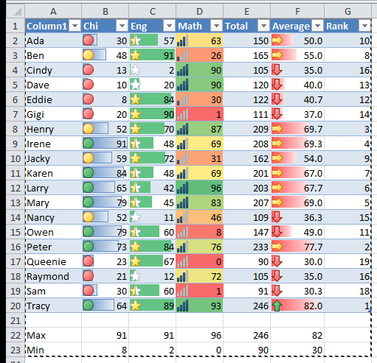
Conditional formatting
Home -> Styles -> Conditional Formatting -> Data Bars
Home -> Styles -> Conditional Formatting -> Color Scales
Home -> Styles -> Conditional Formatting -> Icon Sets

Slide 4
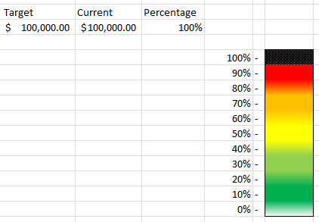
Conditional formatting 2
Home -> Styles -> Conditional Formatting -> New Rule

Slide 5
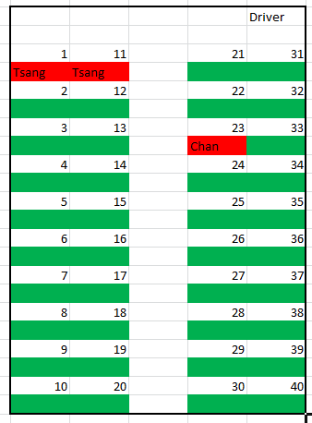
Conditional formatting 3
Home -> Styles -> Conditional Formatting -> Not Blank

Slide 6
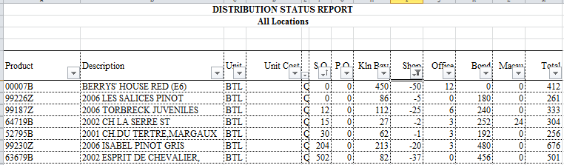
Sort and Filter
Home -> Styles -> Editing -> Sort and Filter
Filter Text / Number

Slide 7
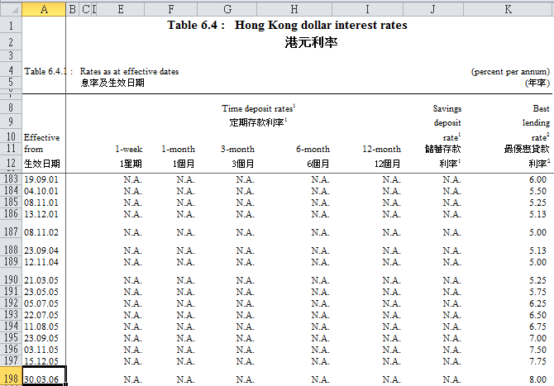
Freeze Pane
Home -> Freeze Panes -> Freeze Panes

Slide 8
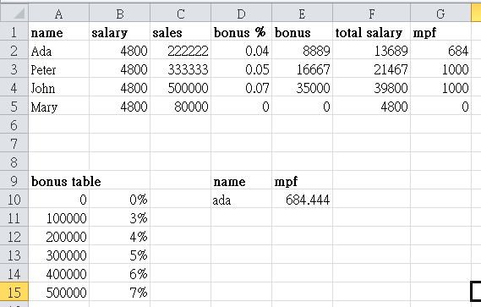
vlookup
Insert Function: =VLOOKUP(C2,bonus,2,TRUE)

Slide 9
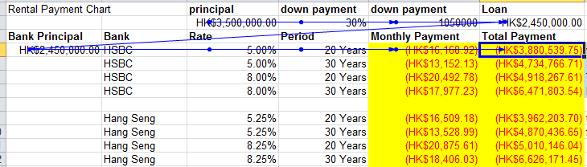
Trace Precedents
Insert Function: =PMT(C4/12,D4*12,$A$4)

Slide 10
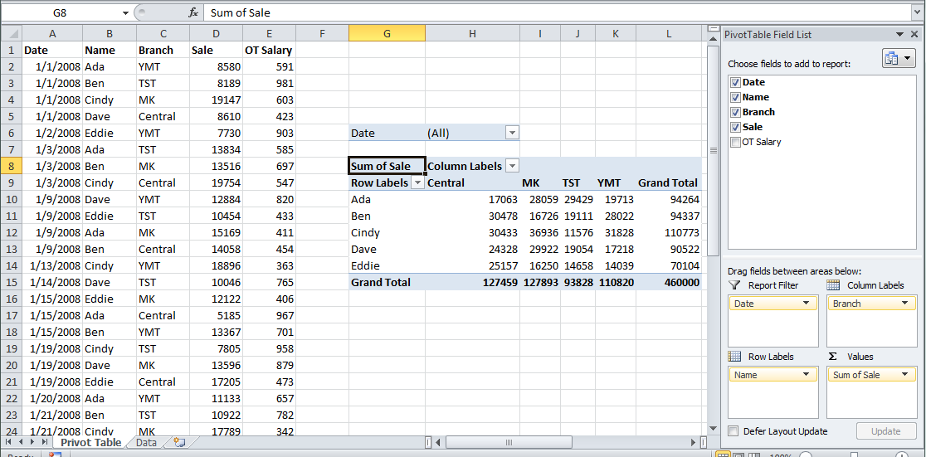
Pivot Table
Insert -> PivotTable -> PivotTable

Slide 11
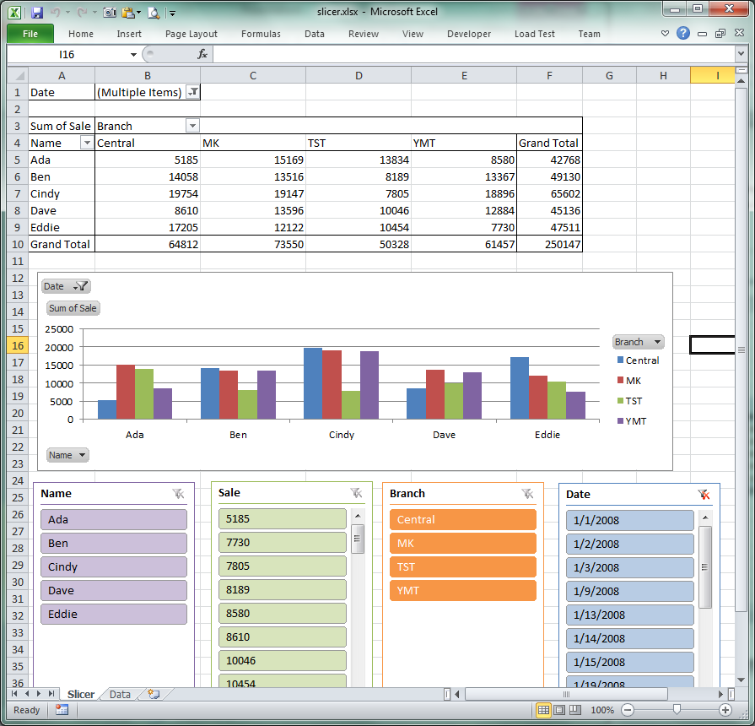
Slicer
Insert -> Filter -> Slicer

Slide 12
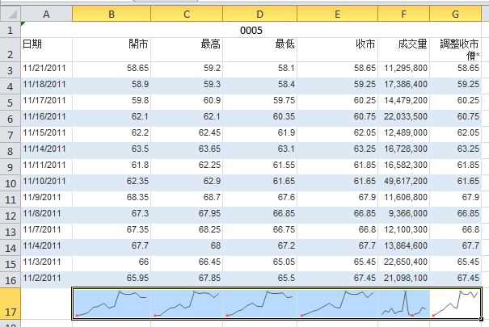
Sparklines
Insert -> Sparklines -> Lines

